Slide 1
Functional Programming
at SimCorp
Florian Biermann, Developer, IBOR
FLBM@Simcorp.com

Slide 2



The speaker
Florian Biermann
ITU alumn
M.Sc. in Software Development (2014)
Ph.D. on parallel, functional programming (2018)
“Data Parallel Spreadsheet Programming”
Developer at SimCorp since August 2018
IBOR Agile Release Train
C# and OCaml
Financial contracts, derivatives, OTC

Slide 3
Simcorp
Investment Management Solutions Provider
Established in 1971
EUR 382.6 million revenue
25 offices globally, main development in DK and UA
1660 employees (2018)
190 SimCorp Dimension clients worldwide
+16,000 users on SimCorp Dimension
Fully integrated front-to-back investment management solution, powered by an award-winning Investment Book of Record, offered globally
190+ clients

Slide 4
Financial Contracts
What Do We Do – And Why?
Bond (loan)
Pay amount up front (nominal)
Pay interest on nominal over time
Pay back nominal in the end
Option (financial instrument)
Right to exercise an underlying contract.
E.g. take up loan on already agreed conditions.
In a period or at specific points in time.
Over-the-Counter (OTC)
Highly customizable financial instruments
Not “centrally cleared”, bilateral agreement.
Like an insurance: if it rains in May, you may buy crops at $5 a pound.
Financial contracts have market value!
Cross-currency trades, interest swaps, Sell-buy-back, …
Notes:
- Interest payments: “coupons”
- Valuation: ”What is my current worth including all my assets?”

Slide 5



SimCorp Technologies
A small selection

Slide 6
What this talk is not about
Dyalog APL
Most code at SimCorp is APL code
In use since the 1970’s
Dynamically typed, interpreted, declarative, array-oriented
C#
Most new development on .NET
Threading, services, GUI
F#
Some components of SimCorp Dimension
SimCorp internal static APL type checker

Slide 7
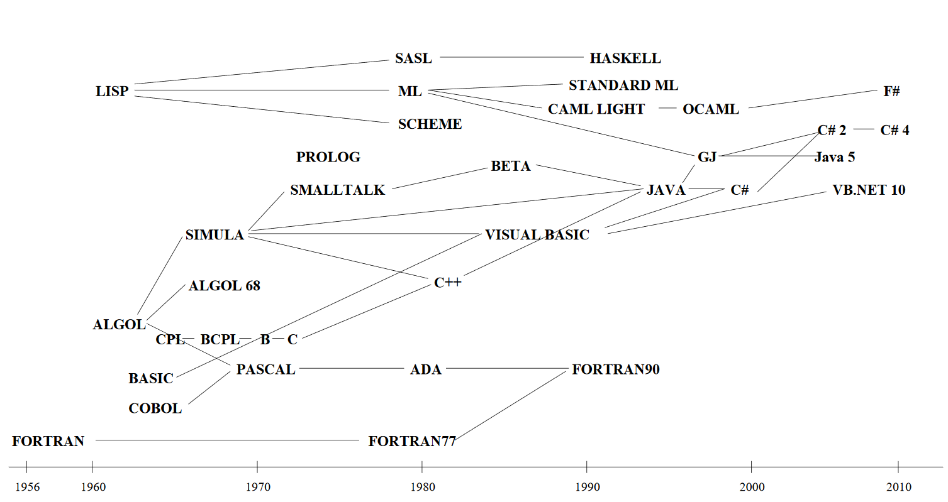
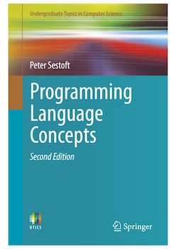
OCaml
Multi-paradigm: functional, imperative, object-oriented
Static types and type inference
Strict evaluation
Interactive top-level (REPL)

Slide 8



Ocaml Types Are Safe
type pizza =
| Crust
| Cheese of pizza
| Sausage of pizza
| Anchovy of pizza
| Onion of pizza
Cheese (Sausage (Onion Crust))
Cheese (Anchovy (Onion Crust))
Crust (Sausage Crust)

Slide 9
Inductive Types Structure Programs
type expr =
| Cst of int
| Add of expr * expr
| Mul of expr * expr
| Neg of expr
let rec eval : expr -> int = function
| Cst i -> i
| Add (e1, e2) -> eval e1 + eval e2
| Mul (e1, e2) -> eval e1 * eval e2
| Neg e -> -(eval e)
# let e1 = Add (Cst 1, Neg (Cst 1));;
val e1 : expr = Add (Cst 1, Neg (Cst 1))
# let e2 = Add (1, Cst 1);;
Error: This expression has type int but an expression was expected of type expr
# eval e1;;
- : int = 0

Slide 10
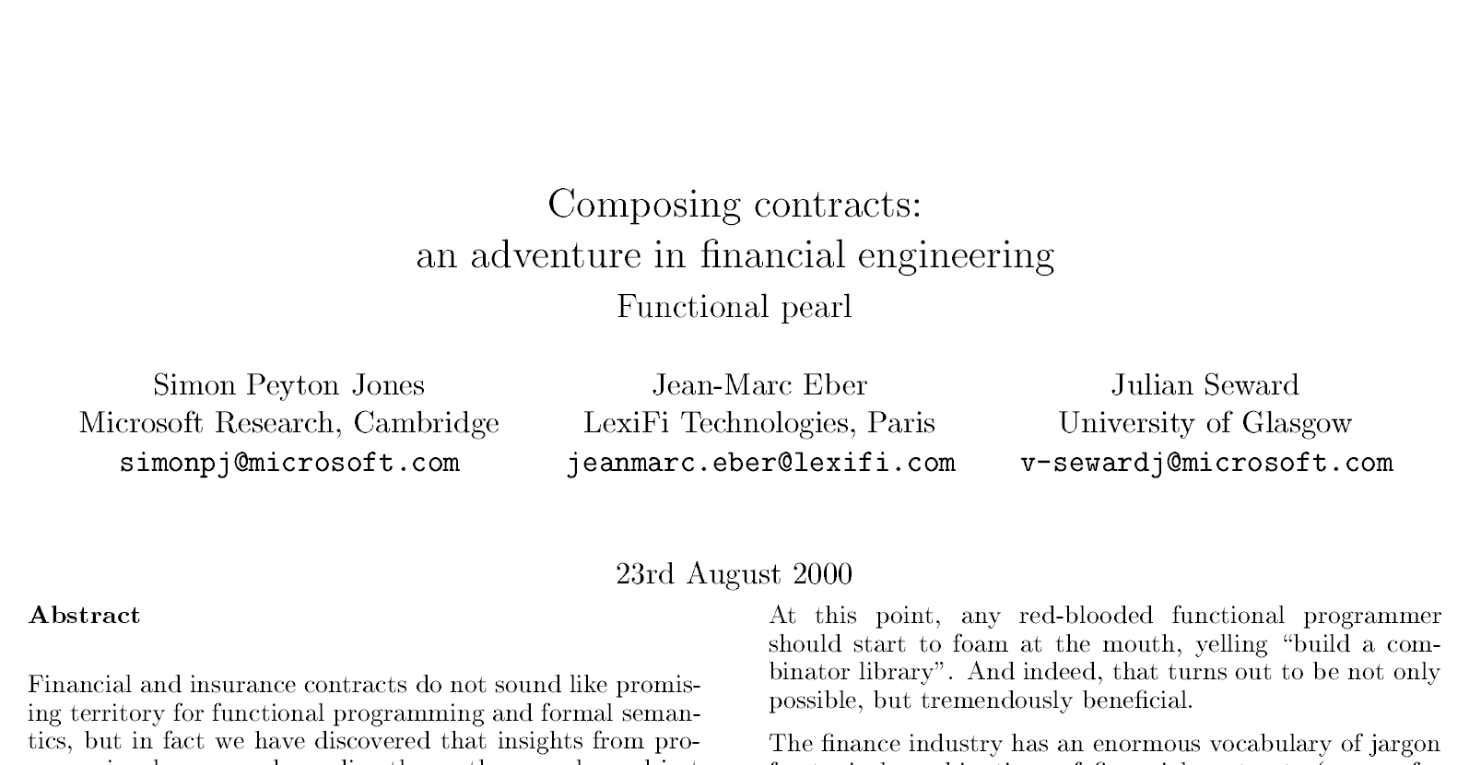

Slide 11
Financial Contracts MOdelling
Two parties agree on an amortized loan.
Pay 30000 DKK up front.
Pay back over three years with interest.
Decide when payments are due.
let amortized_loan =
let principal = cst 30000. in
let coupon = cst 11000. in
all [ give (flow 2019-01-01 DKK principal);
flow 2020-01-01 DKK coupon;
flow 2021-01-01 DKK coupon;
flow 2022-01-01 DKK coupon ]

Slide 12
A Combinator Library for Financial Contracts
Ocaml Dialect MlFi (soon Lexifi Ocaml)
type binop = Add | Sub | Mul | Div | Max
type obs =
| Underlying of string
| Const of float
| Binop of obs * binop * obs
| Fixed of date * obs
type contract =
| One of currency
| Scale of observable * contract
| Acquire of date * contract
| All of contract list
| Give of contract
| Either of contract * contract
| Anytime of date * date * contract * contract
let flow t cur obs =
Acquire (t, Scale (obs, One cur))
let amortized_loan =
let principal = Const 30000. in
let coupon = Const 11000. in
all [ Give (flow 2019-01-01 DKK principal);
flow 2020-01-01 DKK coupon;
flow 2021-01-01 DKK coupon;
flow 2022-01-01 DKK coupon ]
Fix an underlying market rate to its value at some date.
Evaluates to a value of type contract that we can valuate.
Exercise contract in between dates, or exercise other contract after.
Notes:
Symbolic numeric computations
Underlying: look for value from somewhere else, e.g. currency crosses.
Model how to compute value of something.
Combine contracts to build a new contract.
Read the code to the right and deduce what it does.

Slide 13
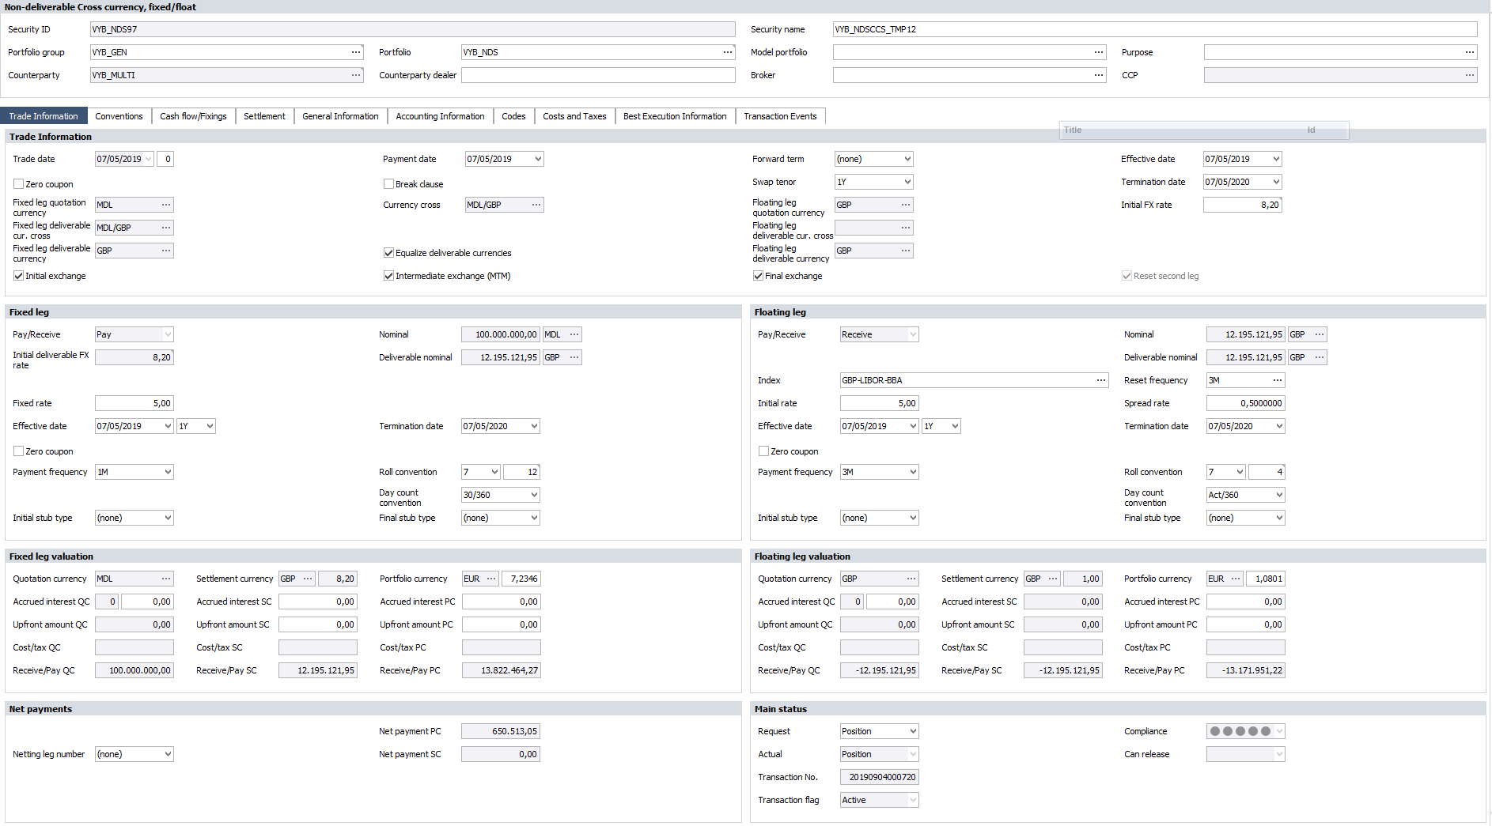
Programming Complex GUI Logic
Programming this in C# is cumbersome and error prone!
Notes:
Trade date + settlement days = payment day
Not just a statement; it is an equation!
Just a small sub-set of existing business rules in this screen.
Imagine implementing all this in C# using event handlers.

Slide 14
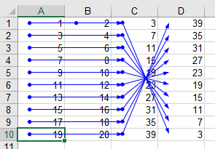
Looks Familiar?
Spreadsheet-Like Evaluation Model
Fields depend on each other
When the user updates a field, all depending fields must be updated, too.
“Reactive programming”
“Self-adjusting computation”
Free of side effects
Programming challenge for domain experts
What happens if the user changes the number settlement days?
Solution: pure, type-safe, declarative programming

Slide 15
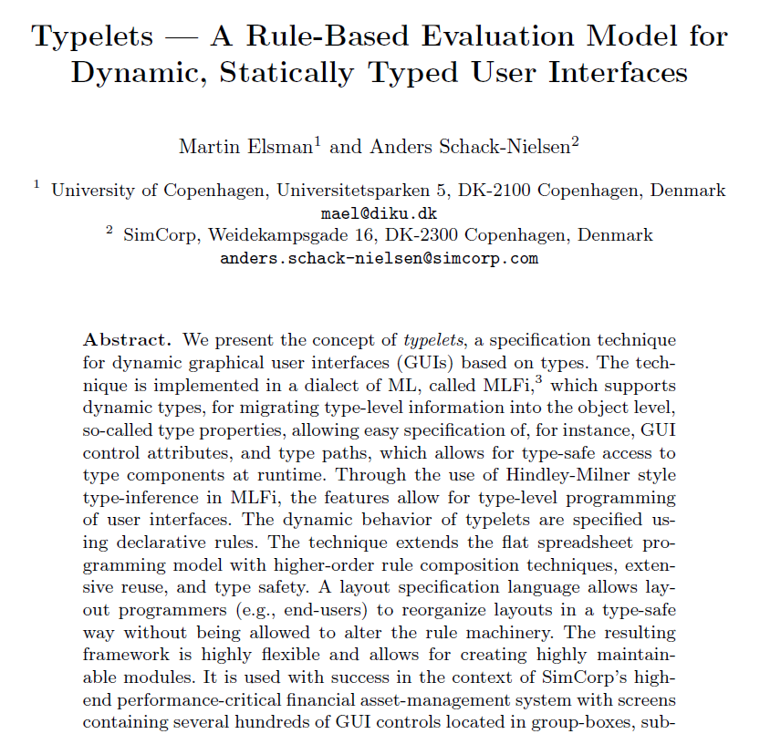

Slide 16

Rules Describe Business Logic
Declaratively Compute Factorial
type t = {
number: int;
result: int + [readonly]
}
let rule =
let rec fact = function
| 0 -> 1
| n -> n * fact (n - 1)
in
Rule.update
(Fields.value (.number))
(Fields.value (.result))
fact
let layout =
let open Layout in
box "Factorial"
(lpick (.number) % lpick (.result))
Use record types to declare fields in the business logic.
Define “normal” OCaml function.
Use it as projection in “update” rule.
Notes:
Type path notation: type t = { x : int };; let x_path = .x;;

Slide 17
Accessing Fields Through Field API
Internal API for Developing Business Logic
a
module type FIELDS = sig
type ('i, 'a) t (* 'i : type of the root *)
(* 'a : type of elements pointed to *)
val const : 'a ttype -> 'a -> ('i, 'a) t
val value : ('i, 'a) path -> ('i, 'a) t
val enabled : ('i, _) path -> ('i, bool) t
val readonly : ('i, _) path -> ('i, bool) t
val restrict : ('i, 'a) path -> ('i, 'a list) t
val (&) : ('i, 'a) t -> ('i, 'b) t -> (‘i, 'a * 'b) t
end
b
type vec2d = { x : float; y : float }
type vec3d = { x : vedc2; z : float }
let f = Fields.value (.x.x) & Fields.value (.x.y) & Fields.value (.z)
What is the type of f?

Slide 18
Constructing Instruments Through Rule API
Internal API for Developing Business Logic
module type RULE = sig
type 'i t
type ('i,'a) fields = ('i,'a) Fields.t
val update : ('i,'a)fields -> ('i,'b)fields -> ('a -> 'b) -> 'i t
val validate : ('i,'a)fields -> ('a -> string option) -> 'i t
val button : ('i,'a)fields -> ('i,'b)fields -> ('a -> 'b) -> ('i,unit)path -> 'i t
val subpath : ('i,'a)tpath -> 'a t -> 'i t
val all : 'i t list -> 'i t
val iso : ('i,'a)fields -> ('i,'b)fields -> ('a -> 'b) -> ('b -> 'a) -> 'i t
...
end
Check whether some property holds for given fields.
Lift rule of type ‘a t into context of ‘i if path from ‘i to ‘a exists.
Isomorphism between two fields.
What does function all : ‘i t list -> ‘i t do?

Slide 19


Rule Execution
Interpeter Implemented in .Net – Business Rules in OCaml
OCaml-C# Interop
Rule data
DB bindings
Layout
Function calls
Rule interpreter
Ordering of execution
GUI generation
Database connection
Input handling
Business rules
Mapping of database fields
Construction of search maps
GUI Layout
github.com/LexiFi/csml

Slide 20
Monadic Rule API
Built-In FFI Requires Deferral of Computations
MLFi run-time is not reentrant.
Data base access & FFI calls are bottlenecks.
Defer computations, allows for optimizations.
Monadic type 'a m!
module Rules : sig =
val update_m : ('i,'a)fields -> ('i,'b)fields -> ('a -> 'b m) -> 'i t
val update : ('i,'a)fields -> ('i,'b)fields -> ('a -> 'b) -> 'i t
end = struct
let update src tgt f =
update_m src tgt (fun x -> return (f x))
end
val return : 'a -> 'a m

Slide 21
Separation of ConCerns
GUI Layout Generation Via Layout API
type base = Number | Button | CheckBox | TextBox | Date | DropDown
type ‘p t =
| Pick of access_path * string option * base
| Hseq of 'p t * ‘p t
| Vseq of 'p t * 'p t
| Halign of halign * 'p t
| Valign of valign * 'p t
| Text of string
| NamedButton of string
| Box of string * ‘p t
let layout =
let open Layout in
box "Factorial"
(lpick (.number) % lpick (.result))
type halign = Left | Center | Right

Slide 22
How Well Does This Work In Practice?
High Re-Use, Fast Time-To-Market
Plug-in system using OCaml Functors:
A system to generate modules from other modules.
Highly composable, type safe, no run-time overhead.
Rule composition possible thanks to purity!
Many business rules are generic!
E.g. business calendar functionality.
Financial instruments differ only in few places.
Re-use factor for business rules is ~10
274’845 lines of OCaml code
428’771 business rules in production
42’132 unique business rules
Over 100 financial instruments

Slide 23
Summary
Functional Programming at SimCorp
Combinator library for modelling financial contracts
Every-day business for us, revolutionary for the finance sector.
Domain experts model contracts.
Declarative business logic for type-safe GUI programming
Similar to constructing a spreadsheet.
Focus on what, not how.
Challenges ahead
You gotta know your stuff:
Polymorphism, existential types, phantom types
Monads & API design
Compositionality & catamorphisms
let rec flatten = function
| [] -> []
| xs :: xxs -> xs @ flatten xss

Slide 24
Thank you!
FLBM@SimCorp.com

